Slide 1
A QUADCOPTER BASED AUTO CAMERAMAN By, DILIP RAJ RAMESH BABU, Graduate Student
December ,2020
Applied Research Project Oral Defense
Committee Chair: Dr. Xiaorong Zhang
Committee Member: Dr. Hao Jiang

Slide 2
Abstract
A quadcopter drone with an onboard microprocessor can be used to perform all the functionalities of a cameraman
These drones can be used to report events such as floods, protests, and wars without any casualties
This project investigated the feasibility of using a quadcopter with an onboard processor, a camera and a Wi-Fi module to transmit streamlined video from the drone to a server
An Arduino-based flight controller was developed, which communicates with a Raspberry Pi computer collecting and transmitting camera data

Slide 3

CONTENTS
Introduction
Types of drones
Single Rotor
Hybrid VTOL
Multi Rotor
Applications of Drones
Drone Market
Product Research
Proposed System
Block Diagram
Hardware Used
Software Implementation
Analysis and Results
Conclusion and Future Work
References

Slide 4
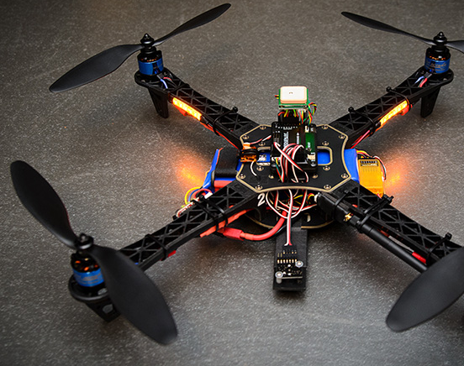
INTRODUCTION
A quadcopter is a type of helicopter with four rotors
They can also be programmed to be autonomous where they can run on their own.
They are small, easy to handle and has multiple functionalities
Based on usage they can be commercial or personal or military.

Slide 5
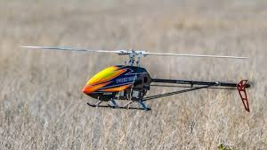
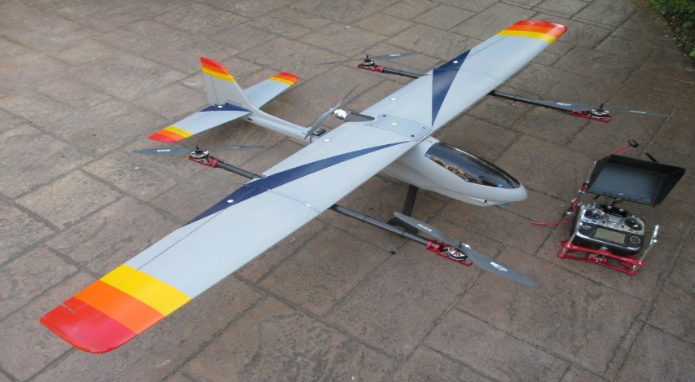
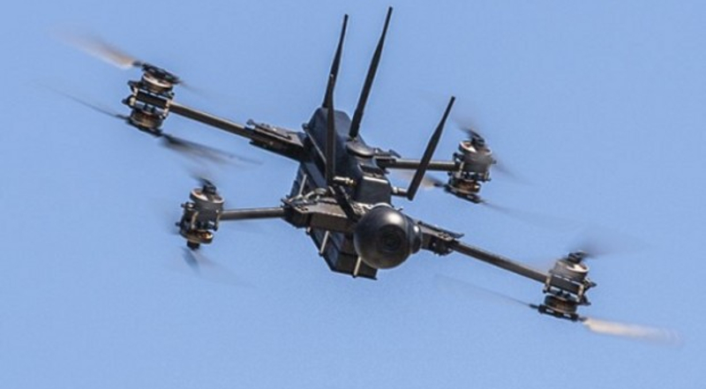
TYPES OF DRONES
There are different types of drones based on the number of rotors and the way it takes off
Single Rotor
Multi Rotor
Hybrid VTOL
These different drones each serve for different purposes.

Slide 6
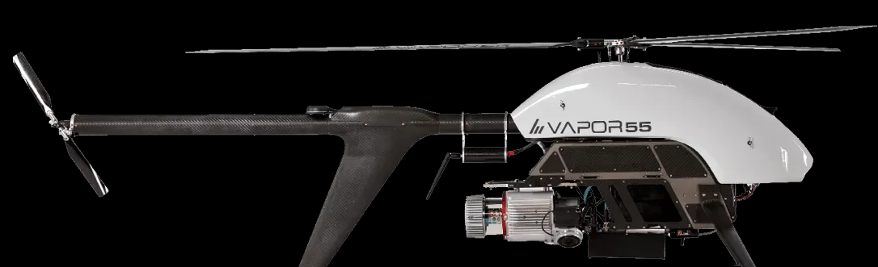
Single Rotor Drones
The most featured single rotor usually resembles a helicopter
As the name suggests, they only have one rotor which is used to control the entire structure
They are efficient in generating more thrust than the multi rotor components
But they are not as stable as multi rotor drones and require more mechanical assistance and maintenance

Slide 7
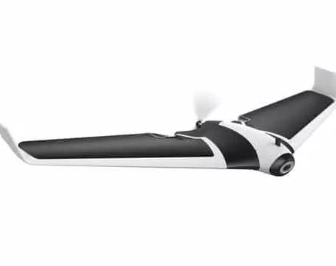
Hybrid VTOLs
Hybrid VTOLs use the principle as airplanes, using wings to generate lift
VTOLs using fixed wing only need energy to keep moving forward
Wings are used to generate vertical lift and is useful for covering long distance
These can stay up for 16 hours when power by gas
But they can hover around one place and makes launching and landing quite problematic

Slide 8
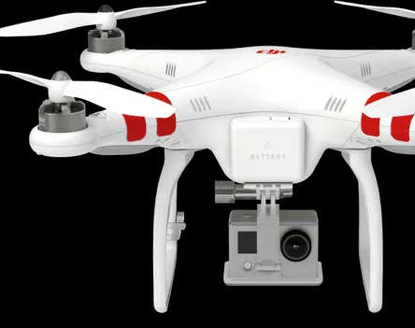
Multi Rotor Drones
This is the most common type of drones for hobbyists and professionals
There are multiple types of multi rotor drones
Multi Rotor drones are used for aerial photography
These drones can only stay airborne for usually 20-30 minutes
The more rotors added, the lesser the flight time

Slide 9
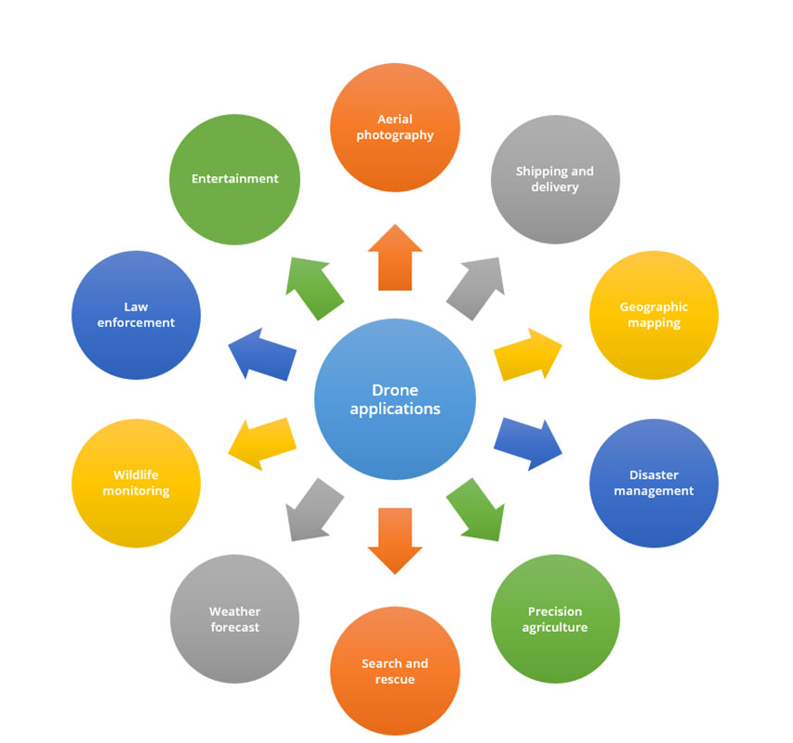
Applications of Drones

Slide 10
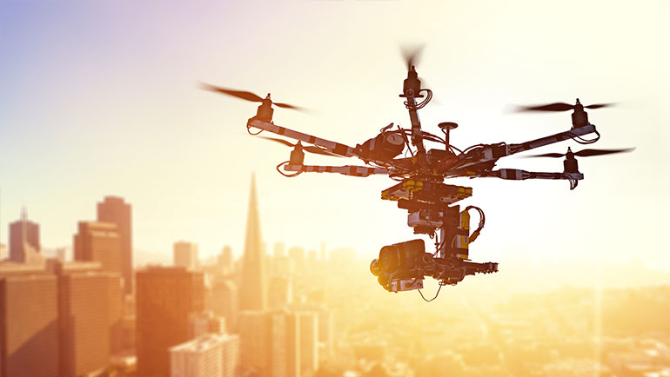
Applications of Drones
Drones are used to capture footage that would make use of expensive helicopters and cranes, which makes cinematography easier
Amazon, UPS and DHL are in favor of drone delivery, where they can be used to deliver small packages and food
With different sensors, high-definition cameras and radars, rescue teams have access to a higher field of view

Slide 11
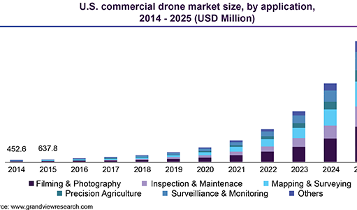
Drone Market
The global commercial drone market size is valued at USD 5.80 billion with over 274,600 units sold in 2018
The market is anticipated to register CAGR of 56.5% during the forecast period
From the graph we can see the prediction of commercial use of drone in the U.S.
Filming and photography is expected to emerge as the maximum revenue generating segment
The advent of UAV enables journalist to cover areas which human entry is prohibited

Slide 12
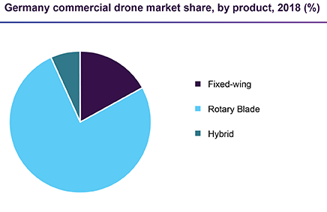
Drone Market
The global demand for fixed-wing drones is poised to expand at a CAGR of over 60%, which are commonly used for topographic surveys, aerial mapping, etc.
The rotary blade/multirotor segment led the market in 2018 and is also projected to maintain dominance
North America accounted for the largest market share in terms of revenue in 2018
Some of the prominent companies are DJI, Parrot Drones SAS, Xiaomi, 3D robotics

Slide 13
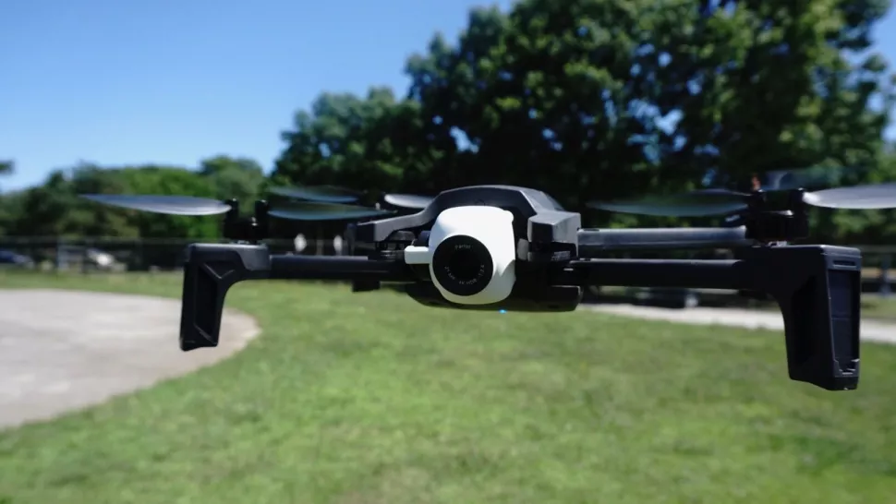
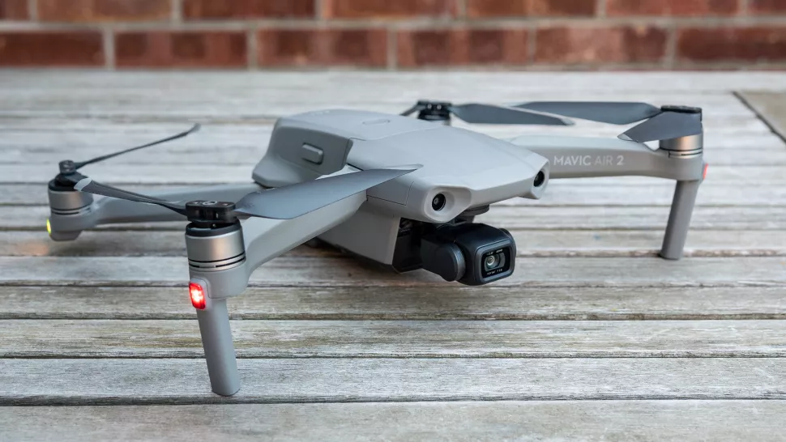
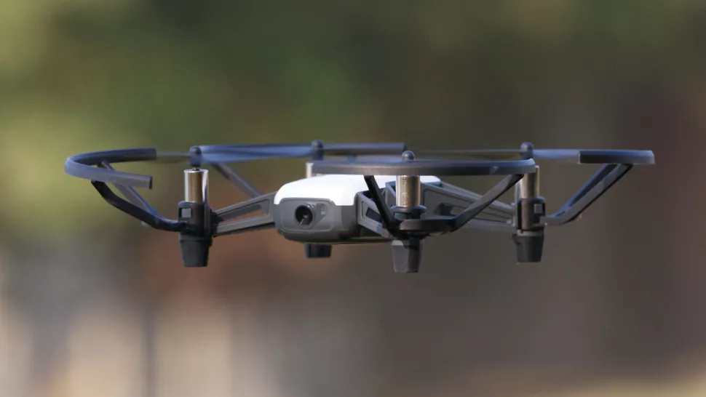
Product Research
The products available in the market usually varies for people who are novice flyers to a pro drone enthusiast
The DJI Mavic Air 2 is the best drone for almost all the people
Ryze Tello is the most affordable drone which has a flight time of 12 minutes and 100m range
Parrot Anafi is a controller which has a camera resolution of 21MP and a battery size 2700mAh

Slide 14
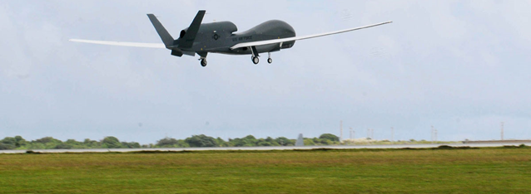
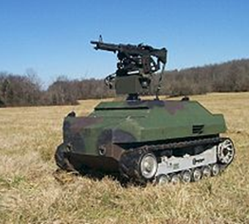
Product Research
Apart from commercial uses, drones are also used by the military for surveillance, intelligence and reconnaissance
Lockheed Martin is the biggest aerospace and defense giants that supply drones to the US military
The military successfully use the drones or UAVs in the war against Iraq and Afghanistan
The drones are not only used for air surveillance but also for ground based tactical warfare

Slide 15
Proposed System
To overcome the effects of large media personnel not entering a small space, quadcopter cameraman can be used to reduce manpower
They can be used to transmit camera data simultaneously
The first part of the proposed system is the face recognition module which detects the face
The detected face is sent as the input to the raspberry pi using the telemetry ports of the flight controller
This in turn pilots the quadcopter to follow the journalist

Slide 16
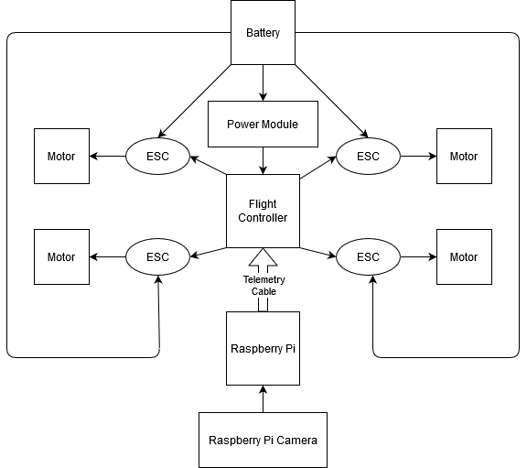
Quadcopter Setup

Slide 17
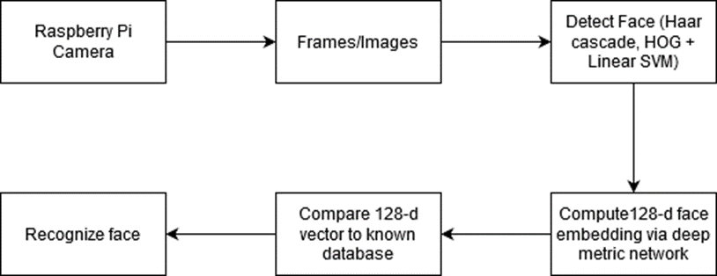
Face Detection Module

Slide 18
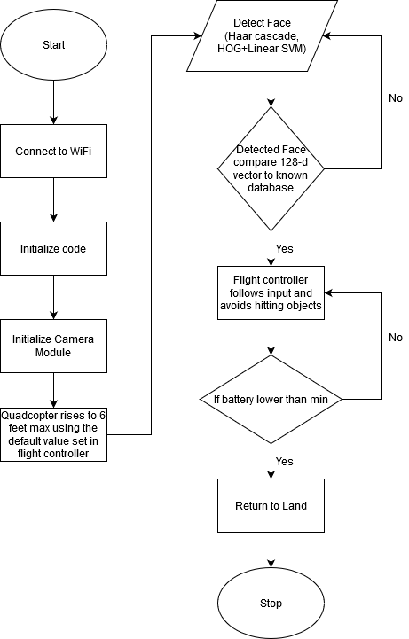
Flowchart

Slide 19
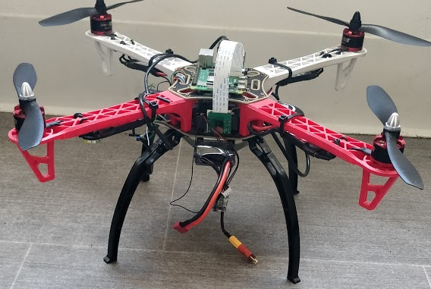
Assembled Model

Slide 20
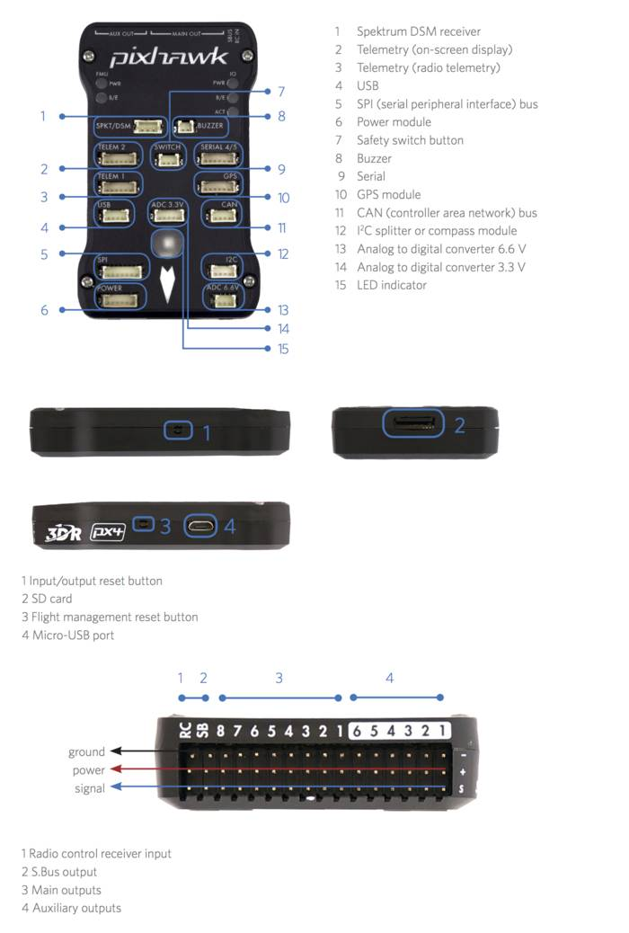
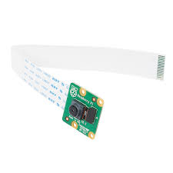
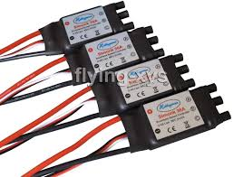
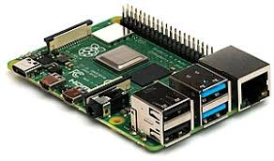
Hardware Used
Raspberry Pi 4 Model B
Flight Controller
Raspberry Pi Camera
Electronic Speed Control

Slide 21
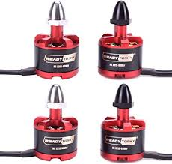
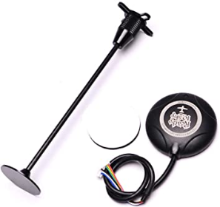
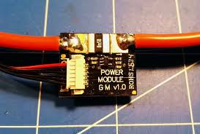
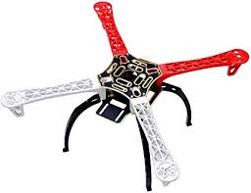
Hardware used
Power Module
Motors
GPS Module
Frame

Slide 22
Software Implementation
Wi-Fi access point
Raspberry Pi has a Wi-Fi chip which can be used to connect to the network
Using VNC server and receiver we can use the remote desktop on top of the raspberry pi
Face Detection Dataset
The first part of the program is to get the face that needs compared to the videostream
OpenCV is used to detect the face and capture the images
Mission Planner
Mission Planner is a GUI software which is used to setup the flight controller
The default values and parameters are setup during this part of the initialization
Only after the basic configuration the flight controller is mounted on the frame

Slide 23
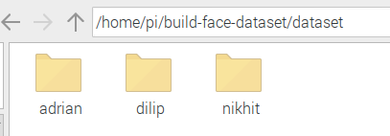
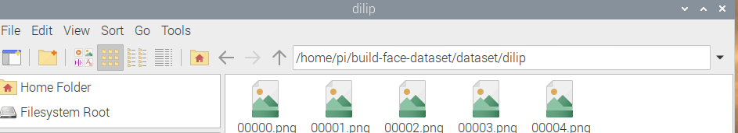
Face Detection Dataset
We use OpenCV to create a dataset of images
A python script is used to open the raspberry pi camera
The letter k is pressed to capture the frame
The captured images are stored in the respective directories
These are the datasets which are used to detect the face of the journalist

Slide 24
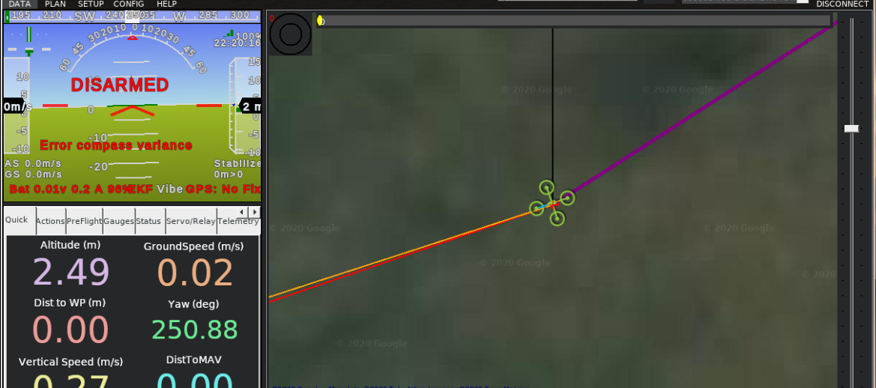
Mission Planner

Slide 25
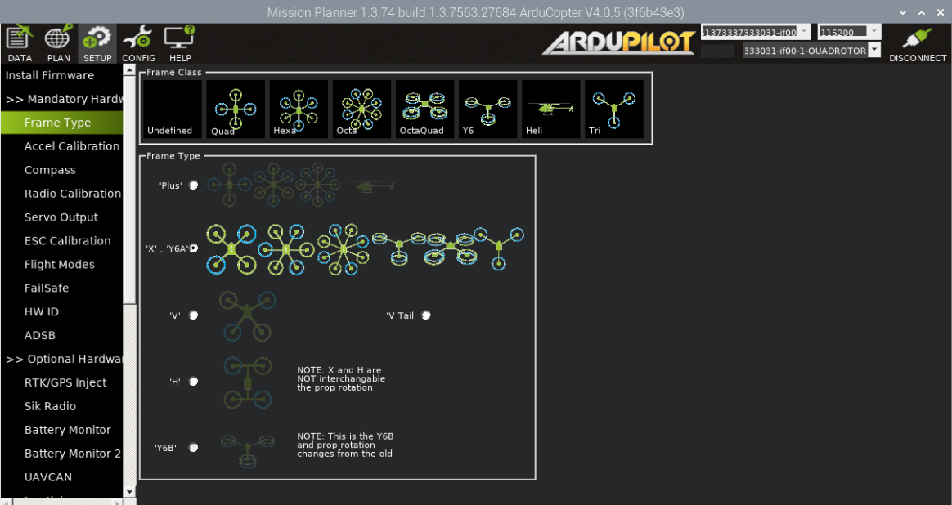
Mission Planner

Slide 26
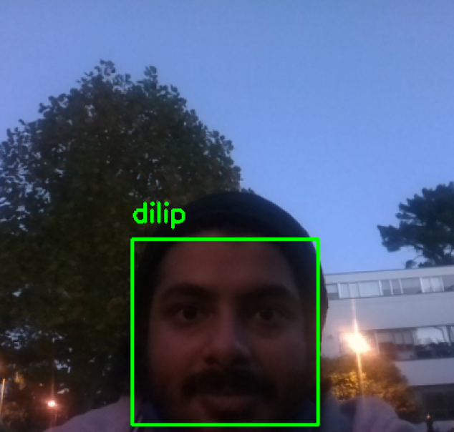
Analysis and Result
The first part of the working mechanism is for the Raspberry Pi Camera to get the VideoStream using OpenCV
The videoStream is then used to detect the face based of the dataset that is stored
The quadcopter uses this frame to make sures that the drone always detects the face

Slide 27
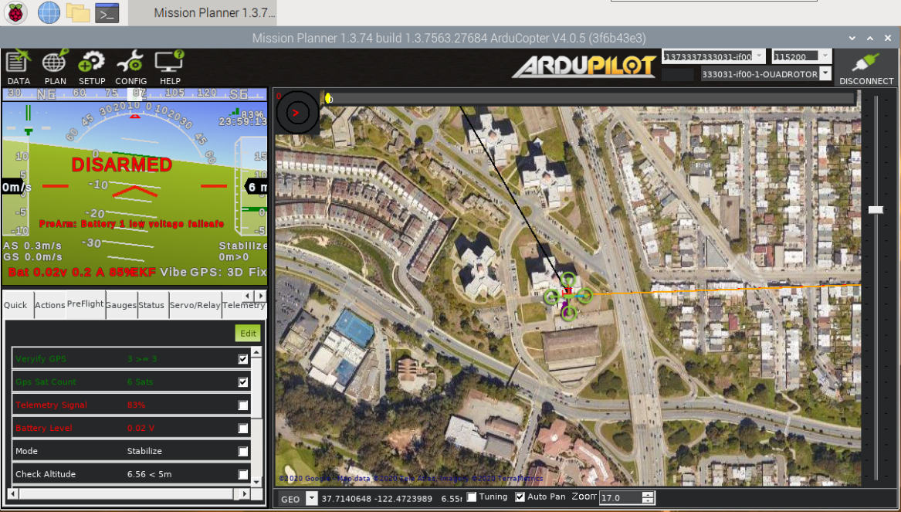
Analysis and Result
There are multiple tests conducted to make sure that the flight does not lose command
There are failsafe set on the flight controller, and it make sures that the drone does not crash
If the GPS location is not set, then the flight controller cannot take off
When the battery goes below the pre-set value of 7V, the flight controller returns to land and starts beeping

Slide 28
Demonstration
A couple of test runs were made, and the quadcopter had a few rough edges
The battery test made sure that the drone stayed in the air for 25 minutes before it started beeping for low battery
A test flight was conducted on campus
https://www.youtube.com/watch?v=WMAaYnShTd4
A video of the experiment is given below
https://youtu.be/2FaYEu2W_Pc

Slide 29
Conclusion and Future Work
A quadcopter with face detection was implemented
It was able to capture the face and stream the video
The drone followed the journalist around
All the properties of the drone were satisfied, and it had a comfortable flight
Making the drone smaller but embedding a flight controller with Raspberry Pi
Longer flight time and reduced delay between frames
Obstacle avoidance and refined transmission of data
More accurate detection of face and following around

Slide 30
References
Kshetri, N., & Rojas-Torres, D. (2018). The 2018 winter olympics: A showcase of technological advancement. IT Professional, (2), 19-25
Jordan, B. R. (2015). A bird’s-eye view of geology: The use of micro drones/UAVs in geologic fieldwork and education. GSA today, 25(7), 50-52
Swider, M., & Wilson, M. (2020, March 9). The best drone 2020: DJI, Parrot and more for beginners and pros. Retrieved April 16, 2020, from https://www.techradar.com/news/best-drones
Sharkey, N. (2011). The automation and proliferation of military drones and the protection of civilians. Law, Innovation and Technology, 3(2), 229-240

